Slide 1
Tic Tac Toe
Presented by
Nafis Fuad Barshan
ID: 21201166
Tanvir Rahan Rifat
ID: 22101065
Md. Adnan Asif
ID: 22101081
Presented to
Nahida Marzan
Lecturur
Department of CSE
University of Asia Pacific

Slide 2
Table of contents
01
02
03
04
05
06
Introduction
MiniMax Algorithm
Alpha Beta Pruning
04
05
06
Input/Output
Report and Code
Conclusion

Slide 3

01
Introduction

Slide 4
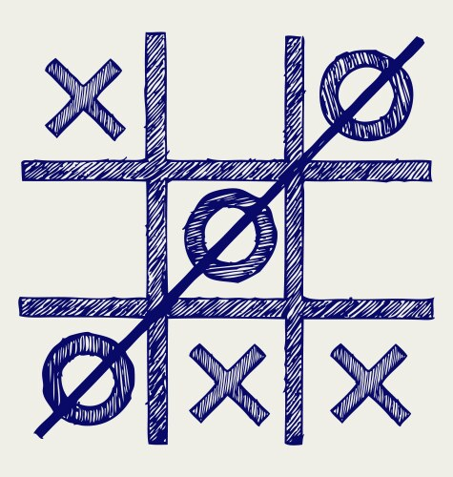
Objective: Develop an intelligent AI for Tic Tac Toe using the Minimax algorithm with Alpha-Beta Pruning.
Game Modes:
Human vs. Computer
Computer vs. Computer

Slide 5
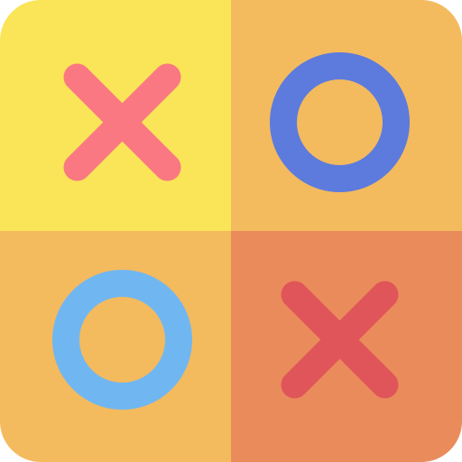
Minimax Algorithm
The Minimax Algorithm is widely used in game theory for decision-making. It
involves evaluating every possible move to determine the optimal strategy for
the AI.
Players:
Maximizer (X): Aims to maximize the score (win).
Minimizer (O): Aims to minimize the score (prevent loss).

Slide 6
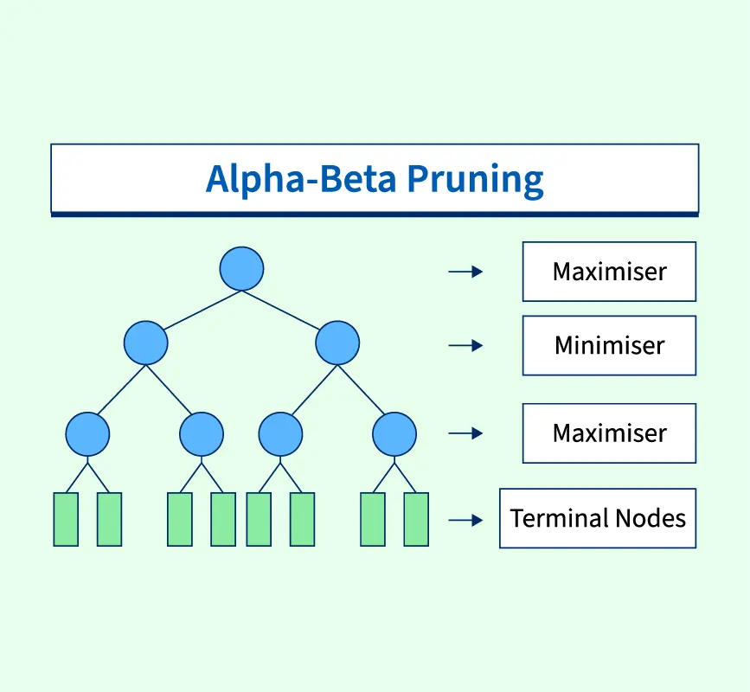
Alpha Beta Pruning
Key Values:
Alpha: Best score Maximizer can guarantee.
Beta: Best score Minimizer can guarantee.
Effect:
Avoids unnecessary calculations.
Enables deeper exploration of the game tree.
Outcome: Faster and more efficient decision-making.

Slide 7

Input/Output

Slide 8
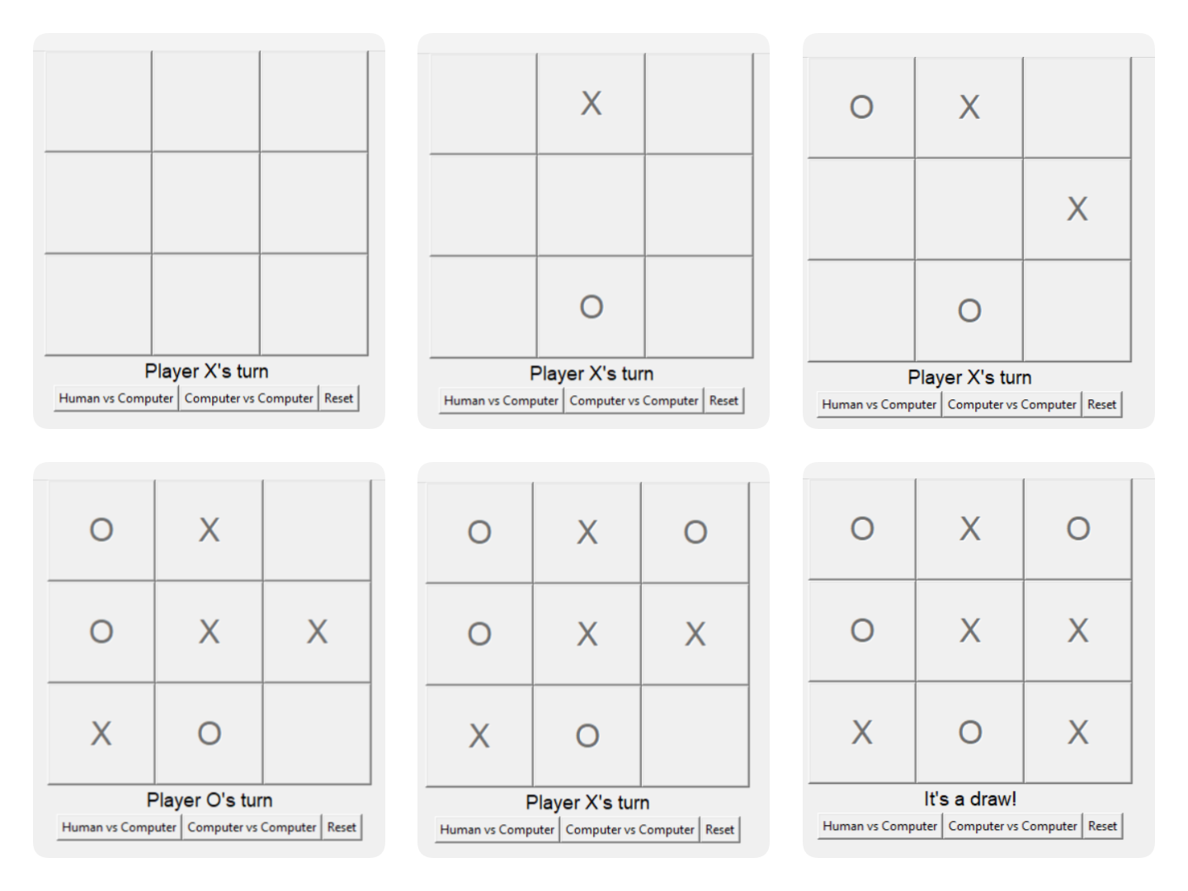
Human VS Computer

Slide 9
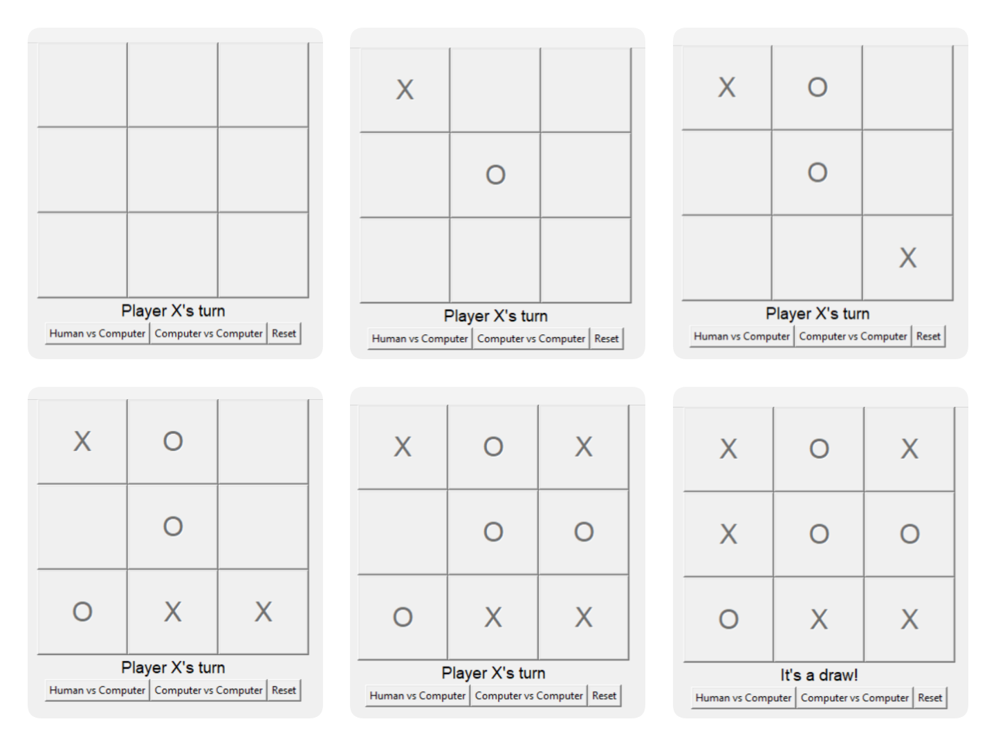
Computer VS Computer

Slide 10
Important Links
Source code: click here…
Technical Report: click here…

Slide 11

Conclusion
Building a Tic Tac Toe game with the Minimax Algorithm and Alpha-Beta Pruning is a great way to learn about AI and game development. Alpha-Beta Pruning helps make the AI more efficient, saving time while still playing well

Slide 12

Thank You

